Slide 1
1. Methodology
Tools used and their applications

Slide 2
1.1 Usage of MS Excel
Why?
Familiarity and comfort over SQL
Alternatives better suited for other purposes
How?
Usage of Power Pivot add-on
Utilizing Pivot Tables for analysis and visuals’ creation
Using helper columns and formulas where necessary

Slide 3
1.2 Data Cleaning
Dates in Transactions[date] not in standardized form –
8th Apr 2025
16th Mar 2025
Data Type Conversion from ‘Text’ to ‘Currency’ for –
Campaigns[goal_amount)
Appeals[goal_amount]
Transactions[amount]

Slide 4
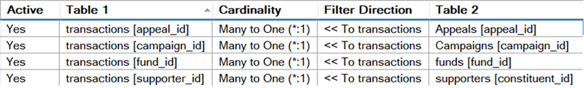
1.3 Relationships between tables
Establishing correct relationships –
Allows pivot tables to connect and aggregate data seamlessly across multiple tables.
Ensure data accuracy and consistency in analysis.

Slide 5
2. Supporter Insights

Slide 6
2.1 Demographics

Slide 7
2.2 Donor Behaviour
*Donors with at least two donations, including one in 2024 or later, are considered regular.

Slide 8
2.3 Preferred Payment Methods

Slide 9
2.4 Top Supporters
Top 5 Individual Supporters
Top 5 Organization Supporters
Supporter ID | Full Name | Average Donation Amount
2749 | Richard Thompson | £112,717.24
2243 | Angela Kelly | £83,817.38
1980 | Sandra Stewart | £71,852.93
4169 | Jessica Gilmore | £70,051.86
3905 | William Chang | £67,543.65
Supporter ID | Organization Name | Average Donation Amount
477 | Whitaker PLC | £636,840.54
465 | Lane, Brooks and Wagner | £274,361.61
480 | Rodriguez Inc | £260,868.75
203 | Garcia-Novak | £250,337.06
434 | Chambers-Strickland | £244,459.82

Slide 10
3. Fundraising Performance

Slide 11
3.1 Campaign-level Performance
Campaign Name | Total Appeals
Earth Protectors Annual Fund | 3
Wildlands Corridor Acquisition | 4
Forest Fire Recovery | 3
Ocean Plastics Initiative | 2
Endangered Species Protection | 2
Youth Environmental Leadership | 3
Native Plant Restoration | 2
Clean Water Action | 4
Conservation Science Center | 2
Year-End Sustainability Drive | 3
Community Garden Network | 5
Renewable Energy Transition | 2
Green Gala Annual Dinner | 3
Trail Blazer 5K Run/Walk | 3
Hike-a-Thon: Miles for Wildlife | 4
Eco Film Festival | 2
River Cleanup Day | 3
Sustainable Living Expo | 2
Polar Plunge for Climate Action | 2
Cycling for Conservation | 4
Moonlight Paddle Fundraiser | 3
Bird-a-Thon Counting Challenge | 3
Tree Planting Day | 4
Nature Photography Auction | 2

Slide 12
3.1.1 Funds Raised Outside Timeframe
Within campaign timeframe? | Total Transactions | Funds Raised
No | 34 | £195,740.68
Yes | 44706 | £197,368,871.80
Grand Total | 44740 | £197,564,612.48
Funds raised outside of campaign date range all came from –
Year-End Sustainability Drive (Campaign ID 10)
Green Gala Annual Dinner (Campaign ID 13)

Slide 13
3.2 Appeal Performance
Out of 70 total appeals, 59 (~84%) appeals reached their goal amount. The following eleven appeals not only failed to reach their goals, they did not receive a single donation -
Appeal Name | Financial Year | Goal Amount
Board Giving - Wildlands Corridor Acquisition | 2024/25 | £10,000.00
Peer to Peer - Hike-a-Thon: Miles for Wildlife | 2024/25 | £25,000.00
Peer to Peer - Eco Film Festival | 2021/22 | £5,000.00
Peer to Peer - River Cleanup Day (Appeal ID 49) | 2024/25 | £5,000.00
Peer to Peer - River Cleanup Day (Appeal ID 50) | 2024/25 | £5,000.00
Peer to Peer - Sustainable Living Expo | 2023/24 | £5,000.00
Peer to Peer - Cycling for Conservation | 2024/25 | £50,000.00
Peer to Peer - Cycling for Conservation | 2021/22 | £25,000.00
Peer to Peer - Bird-a-Thon Counting Challenge | 2021/22 | £5,000.00
Peer to Peer - Tree Planting Day | 2022/23 | £25,000.00
Peer to Peer - Tree Planting Day | 2023/24 | £5,000.00

Slide 14
3.2.1 Funds Raised Outside Timeframe
Within appeal timeframe? | Total Transactions | Funds Raised
No | 35* | £195,896.48
Yes | 44705* | £197,368,716.00
Grand Total | 44740 | £197,564,612.48
Most transactions out of appeal date range occurred almost a year after the appeal ended. Majority of outside timeframe transactions occurred for –
Monthly Giving Program - Year-End Sustainability Drive (Appeal ID 26)
Social Media Challenge - Green Gala Annual Dinner (Appeal ID 38)
*Difference in transactions due to ‘Social Media Challenge - Trail Blazer 5K Run/Walk’ appeal (07/03/25 – 18/03/25) not being within the date range of its campaign (07/12/24 – 05/06/25).

Slide 15
3.3 Fund Performance

Slide 16
4. Temporal Analysis
Analysis of time-related data

Slide 17
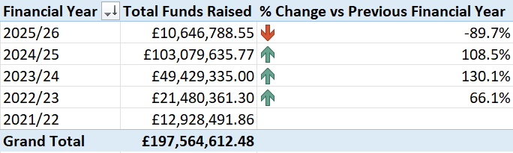
4.1 Yearly Fundraising Performance
Financial Year starts from the 1st April
*2025/26 financial year started on 1st April 2025

Slide 18
4.2 Fundraising Heatmap
 | F Period
F Year | P01 (Apr) | P02 (May) | P03 (Jun) | P04 (Jul) | P05 (Aug) | P06 (Sep) | P07 (Oct) | P08 (Nov) | P09 (Dec) | P10 (Jan) | P11 (Feb) | P12 (Mar)
2021/22 | £125,241.85 |  | £1,042,049.60 | £1,027,843.22 | £2,012,340.82 |  | £833,788.54 | £3,487,565.46 | £836,339.44 | £1,831,171.92 |  | £1,732,151.02
2022/23 | £4,622,606.53 |  | £422,548.98 | £1,287,869.15 | £1,428,223.27 | £581,602.80 | £1,743,289.76 | £5,057,403.27 | £1,205,005.30 | £3,671,388.26 | £77,914.39 | £1,382,509.58
2023/24 |  | £662,913.84 | £936,765.53 | £394,530.76 | £578,405.14 | £943,100.46 | £5,868,039.60 | £8,689,725.86 | £1,040,810.40 | £11,078,170.13 | £12,302,578.83 | £6,934,294.46
2024/25 | £5,328,411.11 | £1,932,402.16 | £3,326,125.74 | £6,409,868.18 | £16,754,430.00 | £5,031,902.40 | £22,186,591.48 | £8,251,346.93 | £15,515,279.96 | £4,899,027.70 | £5,014,696.37 | £8,429,553.72

Slide 19
5. Additional Insights

Slide 20
5. Additional Insights
Transaction Amounts - negative values found; requires investigation.
No strong correlation between appeal timings and whether they reach fundraising goals.
Transaction ID | Date | Financial Year | Financial Period | Amount
18958 | 19/08/2024 | 2024/25 | P05 | -£540,389.22
34845 | 29/01/2025 | 2024/25 | P10 | -£358,546.14
Appeal Name | F Year | P01 | P02 | P03 | P04 | P05 | P06 | P07 | P08 | P09 | P10 | P11 | P12
Board Giving - Wildlands Corridor Acquisition | 2024/25 |  |  |  | X
Peer to Peer - Hike-a-Thon: Miles for Wildlife | 2024/25 |  |  |  |  |  |  | X
Peer to Peer - Eco Film Festival | 2021/22 |  |  | X
Peer to Peer - River Cleanup Day | 2024/25 |  |  |  |  |  | X
Peer to Peer - River Cleanup Day | 2024/25 |  |  |  |  |  |  |  | X
Peer to Peer - Sustainable Living Expo | 2023/24 |  |  |  | X
Peer to Peer - Cycling for Conservation | 2024/25 |  |  |  |  |  |  |  |  |  |  |  | X
Peer to Peer - Cycling for Conservation | 2021/22 |  | X
Peer to Peer - Bird-a-Thon Counting Challenge | 2021/22 |  |  |  |  |  |  | X
Peer to Peer - Tree Planting Day | 2022/23 |  |  |  |  |  |  |  |  | X
Peer to Peer - Tree Planting Day | 2023/24 | X
Grand Total |  | 1 | 1 | 1 | 2 | 0 | 1 | 2 | 1 | 1 | 0 | 0 | 1

Slide 21
End of Presentation

